Slide 1
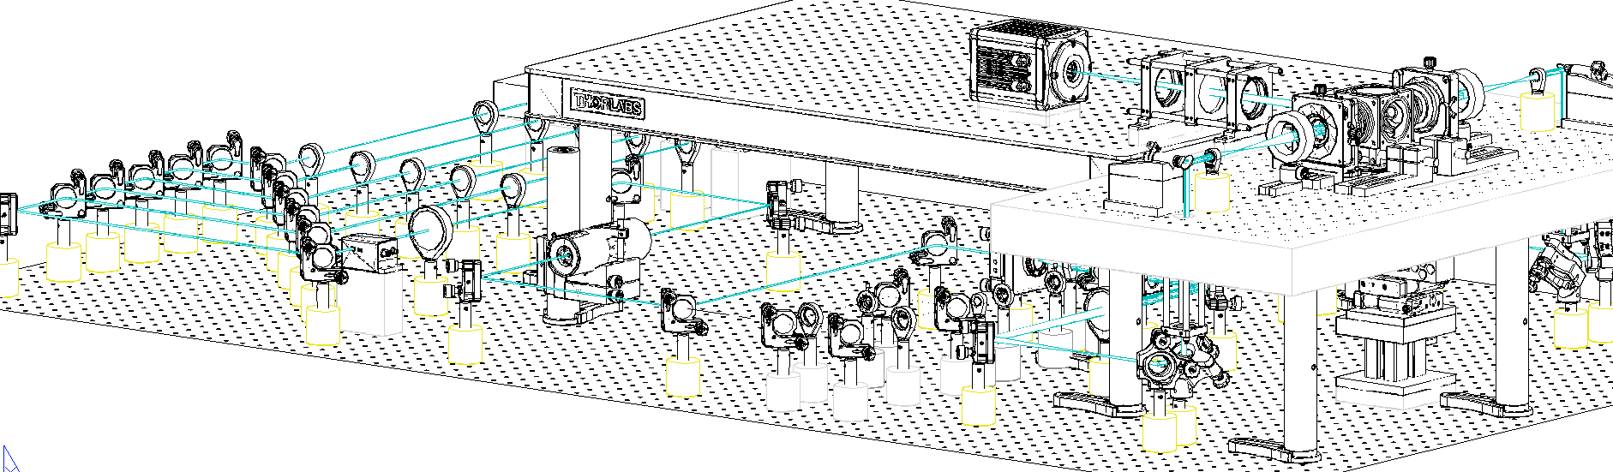
A
561 nm
515 nm
491 nm
445 nm
405 nm
Detection
Olympus
25×, 1.0NA
WD: 8mm
v
f 200
galvo
Camera
filter
f 200
f 50
f 140
f 350
f 100
v
f 200
Axicon
f 50
D
LP 552
PBS
LP 503
I
Nikon CFI LU Plan Fluor EPI 10×, NA 0.30, WD 17.5 mm
LP 466
I
f 350
f 150
LP 427
f 100
f 50
f 150
LM
f 50
C
AOTF
f 100
f 250
galvo
I1
I2
f 50
f 150
A
B
f 200
B

Slide 2
A
561 nm
515 nm
491 nm
445 nm
405 nm
Detection
Olympus
25×, 1.0NA
WD: 8mm
v
f 200
galvo
Camera
filter
f 200
f 50
f 140
f 350
f 100
v
f 200
Axicon
f 50
D
LP 552
PBS
LP 503
I
Nikon CFI LU Plan Fluor EPI 10×, NA 0.30, WD 17.5 mm
LP 466
I
f 350
f 150
LP 427
f 100
f 50
f 150
LM
f 50
C
AOTF
f 100
f 250
galvo
I1
I2
f 50
f 150
A
B
f 200
B
Motor
stages
Periscope

Slide 3
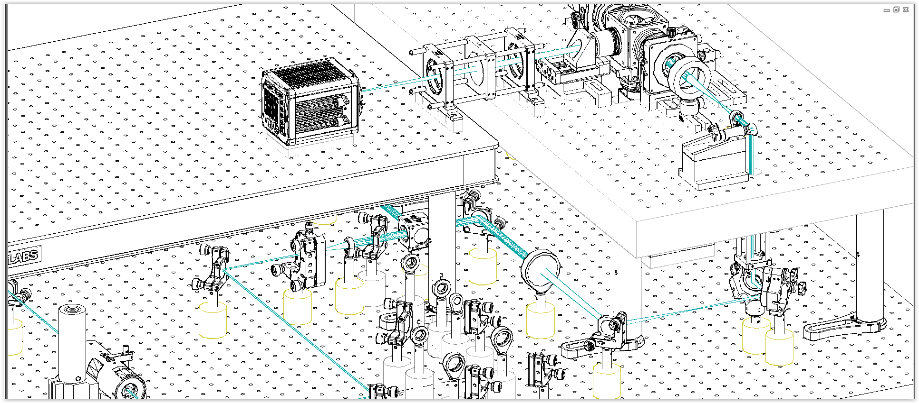
A
561 nm
515 nm
491 nm
445 nm
405 nm
Detection
Olympus
25×, 1.0NA
WD: 8mm
v
f 200
galvo
Camera
filter
f 200
f 50
f 140
f 350
f 100
v
f 200
Axicon
f 50
D
LP 552
PBS
LP 503
I
Nikon CFI LU Plan Fluor EPI 10×, NA 0.30, WD 17.5 mm
LP 466
I
f 350
f 150
LP 427
f 100
f 50
f 150
LM
f 50
C
AOTF
f 100
f 250
galvo
I1
I2
f 50
f 150
A
B
f 200
B

Slide 4
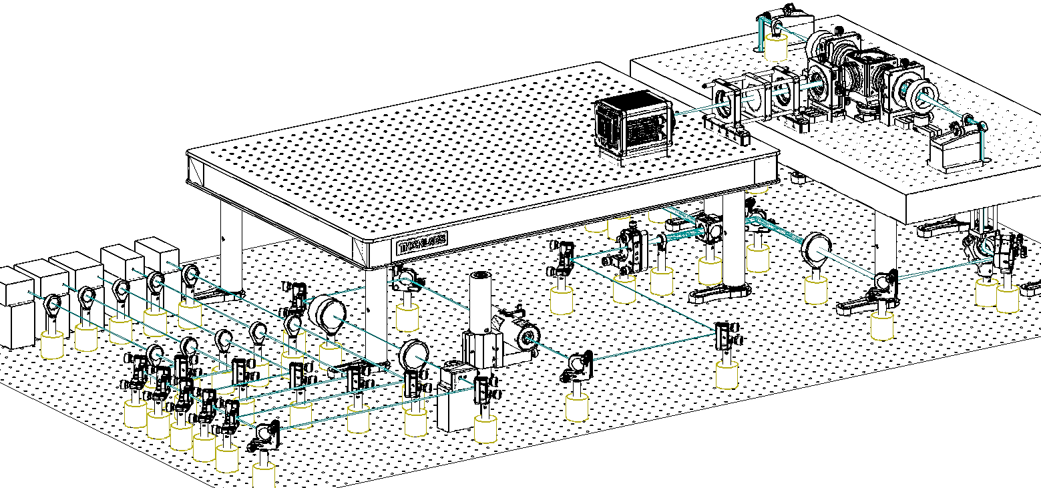

Slide 6
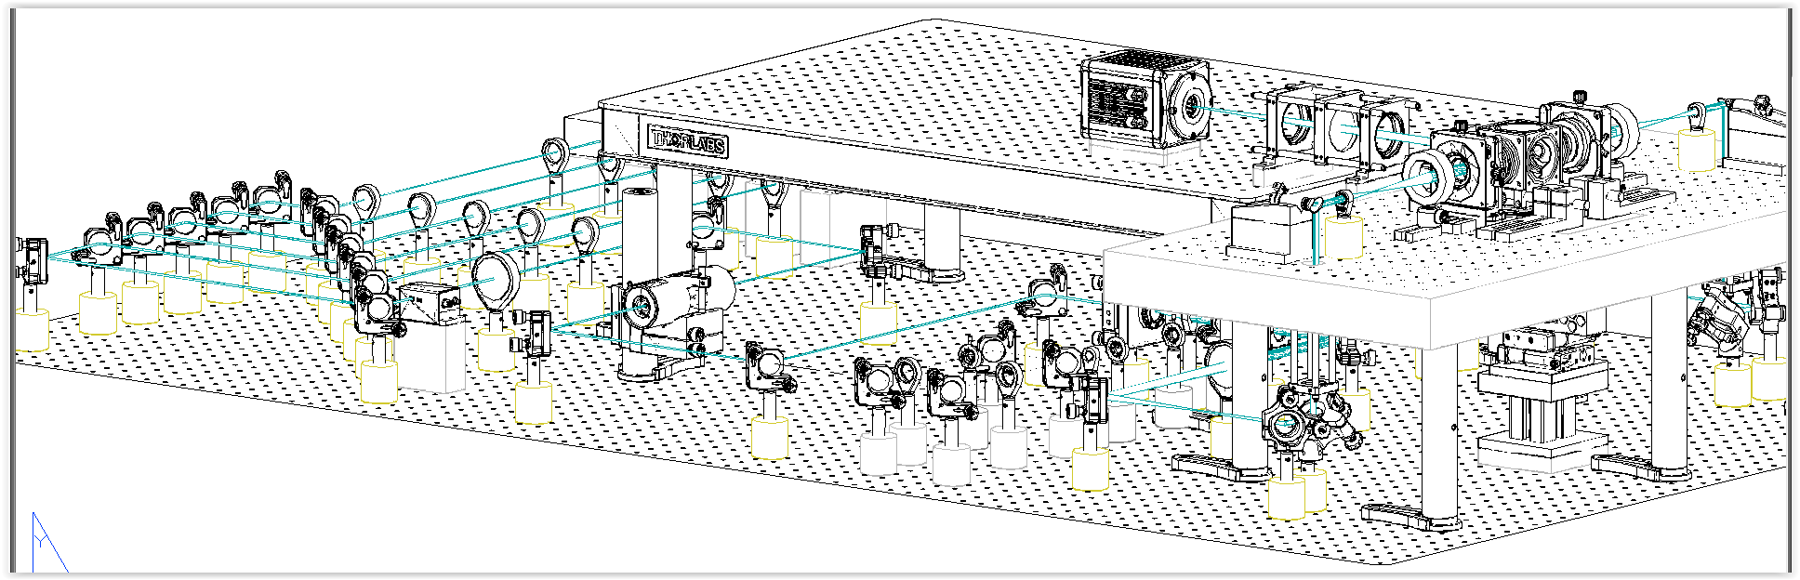

Slide 7
Olympus XLSLPLN25XGMP
25×, 1.0NA
WD: 8mm
Camera
f 200

Slide 8
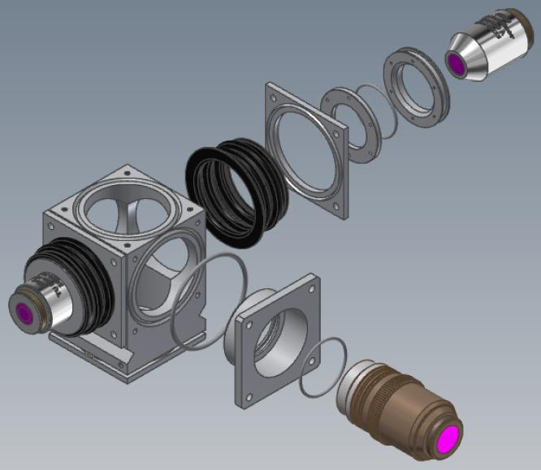
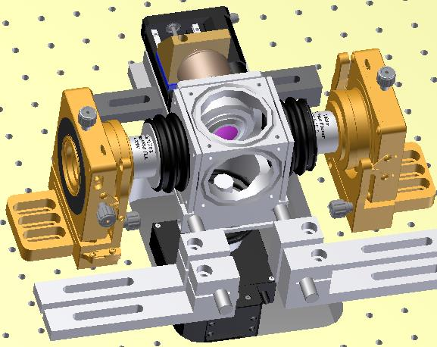
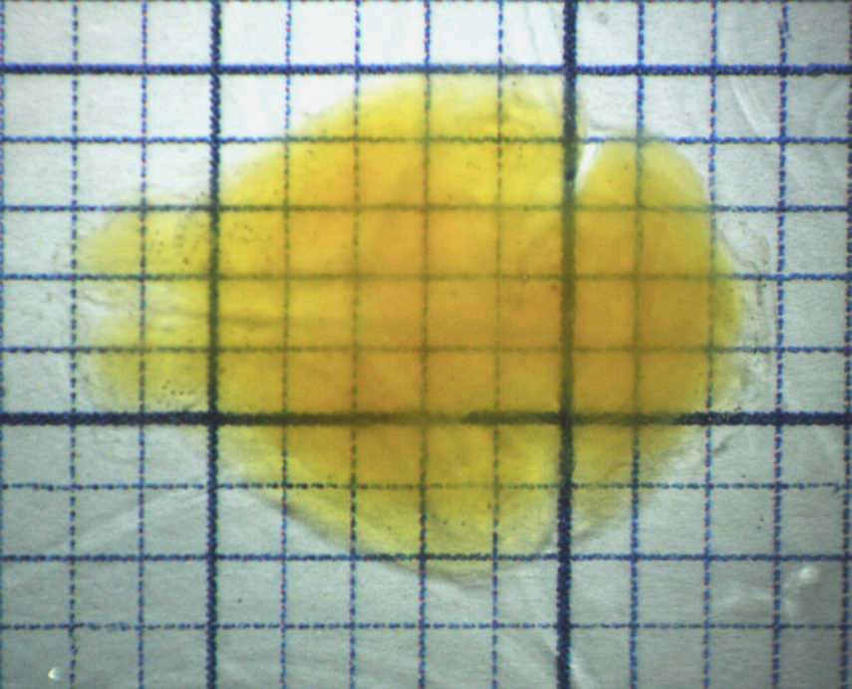
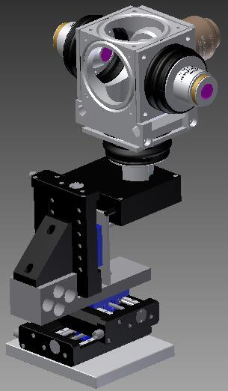
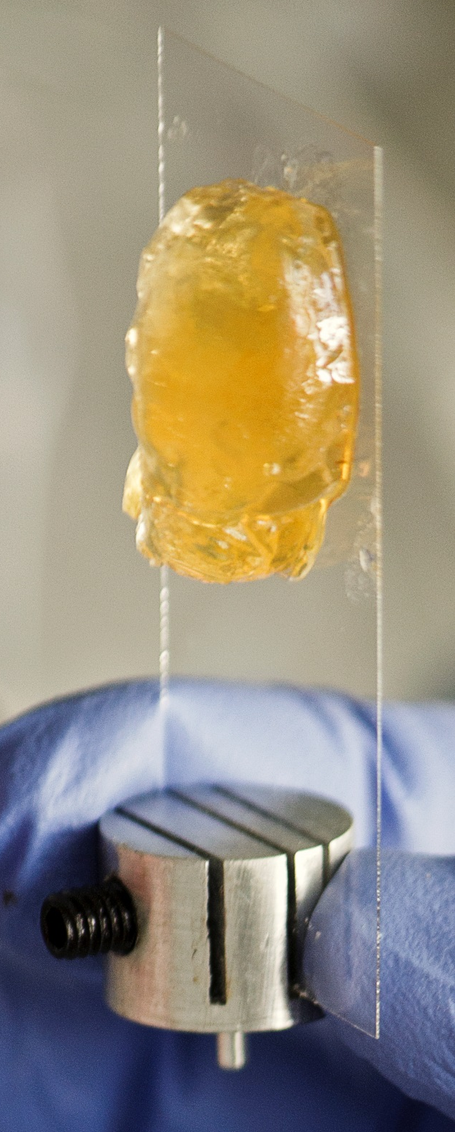
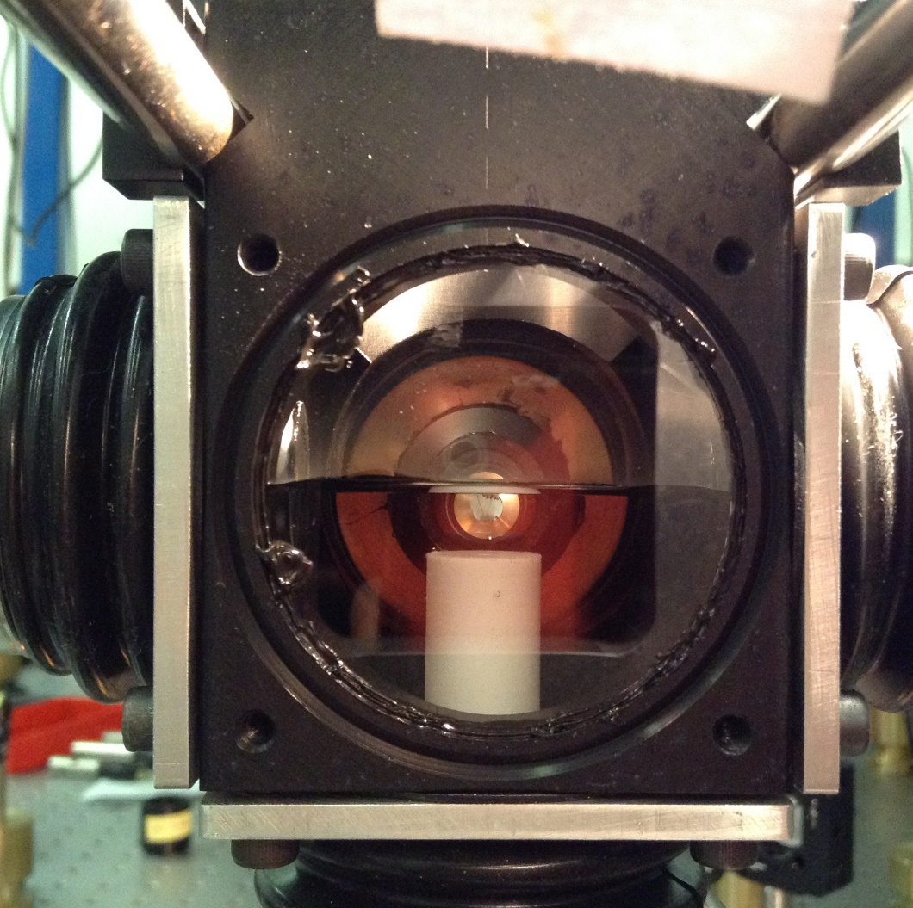
z
A
B
D
E
x
C

Slide 9
z
A
B
D
x
C

Slide 10
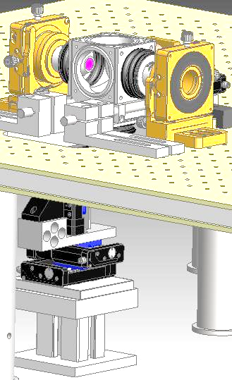
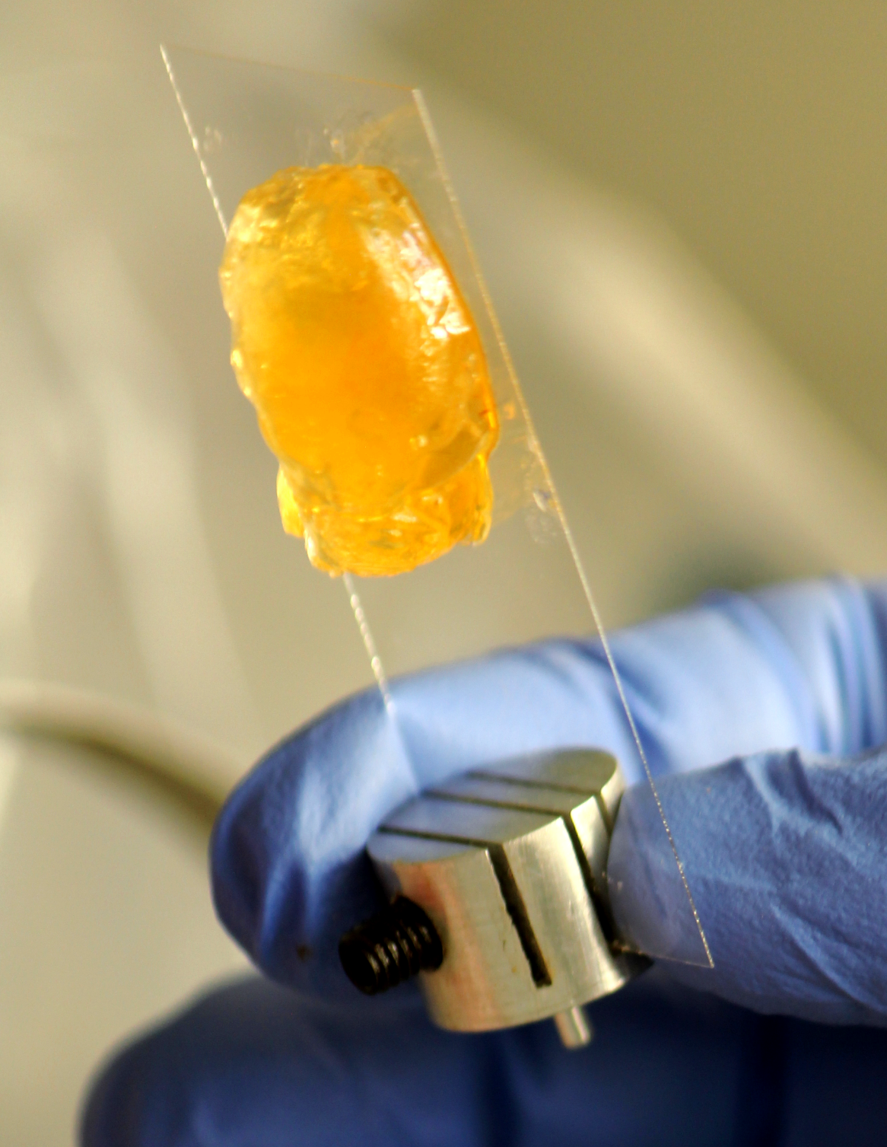
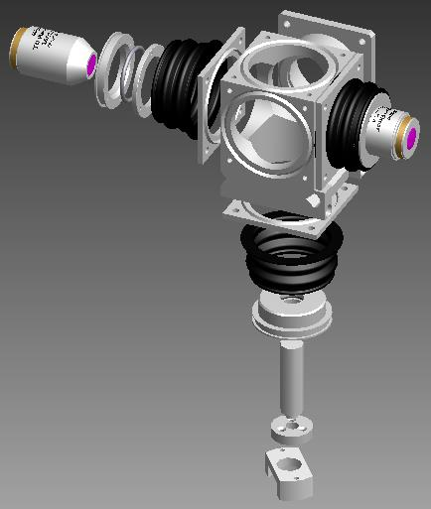

Slide 11
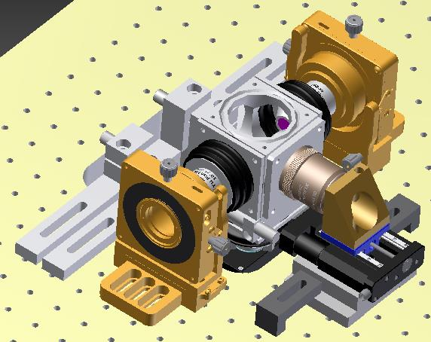
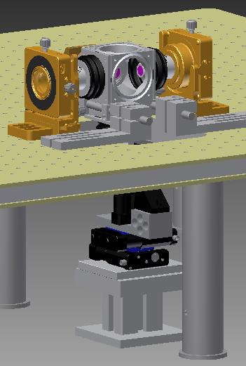
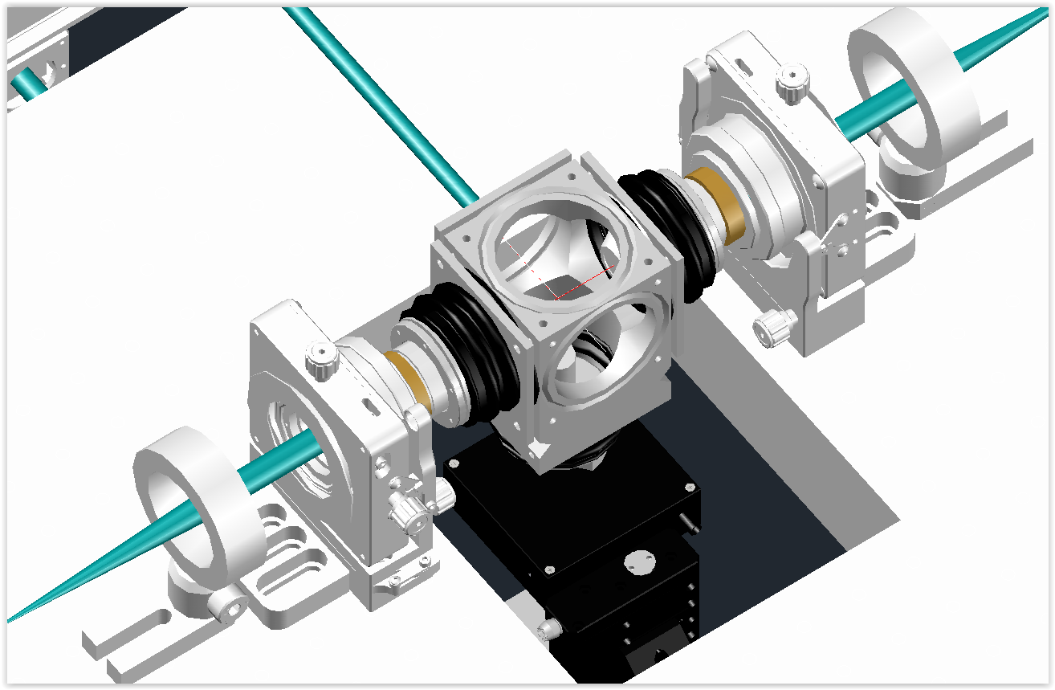

Slide 12
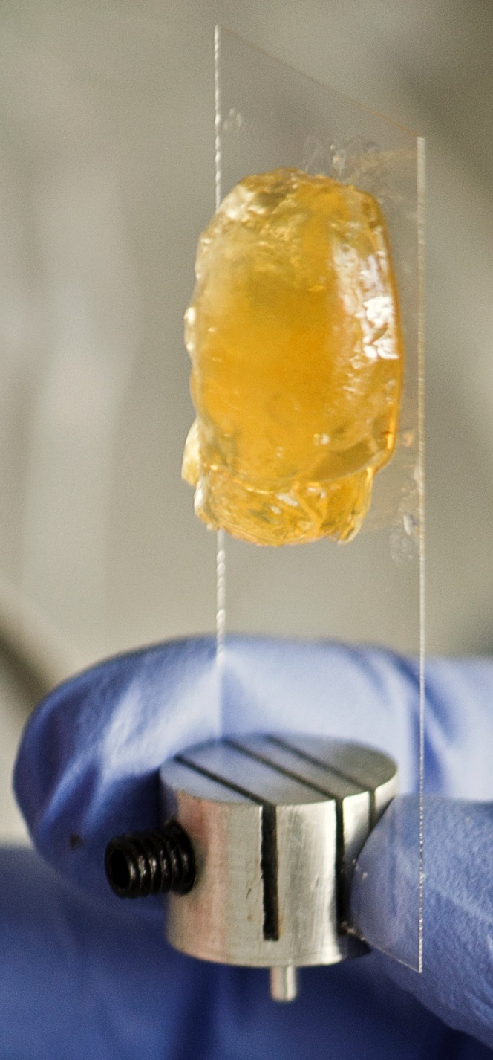

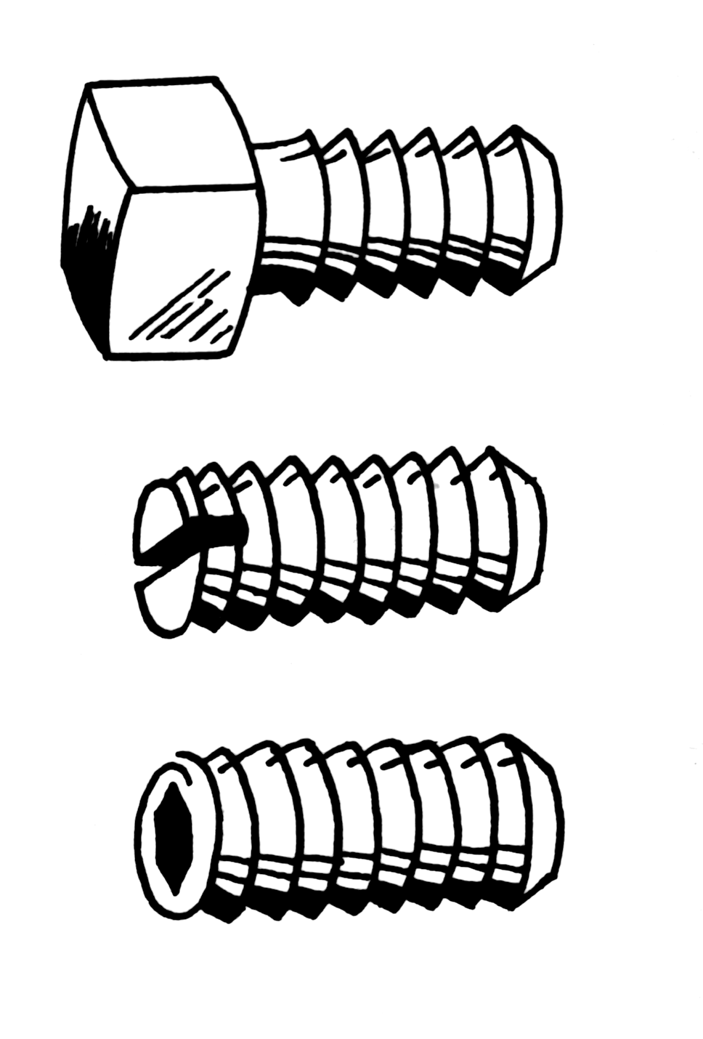
A
B

Slide 14
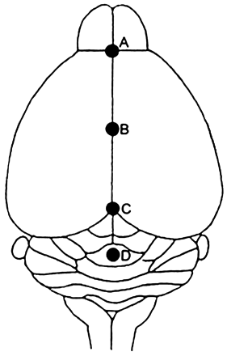
Camera
f 100
f 200
Olympus XLSLPLN25XGMP
25×, 1.0NA
WD: 8mm
f 100
DMM
f 80
f 300

Slide 15
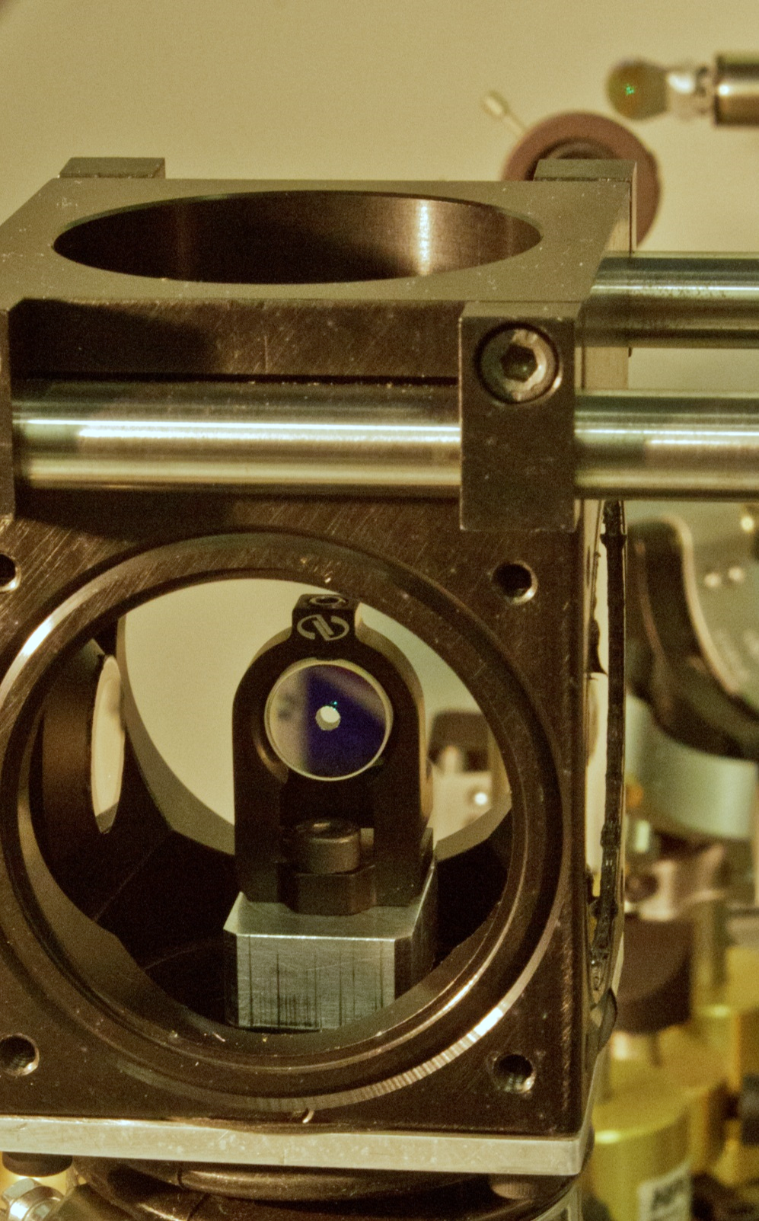
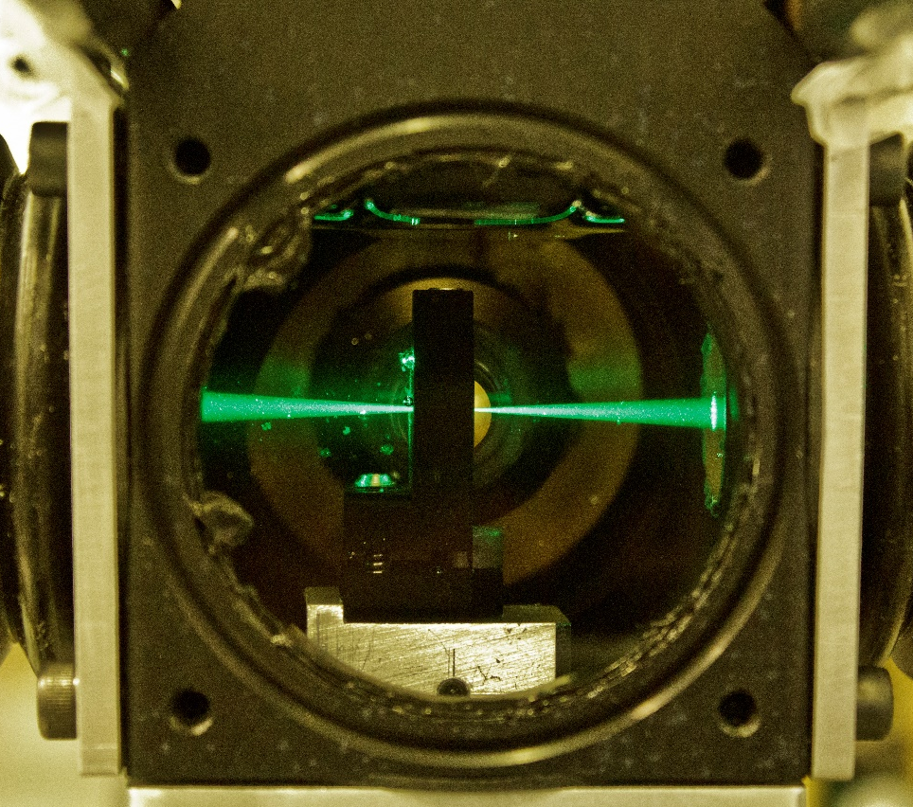
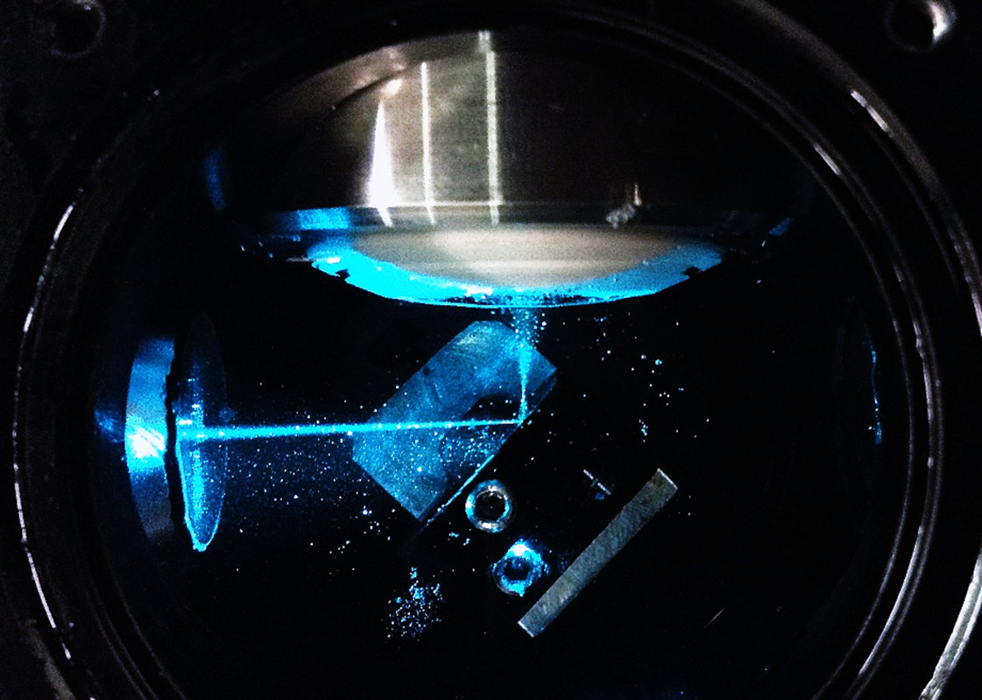
A
Camera
B
C
PBS
AD 350
AD 350
AD 200
D
AD 200
AD 200
v
AD 50
AD 100
AD 100
AD 50

Slide 16
Camera
1’ image plane
PBS
AD 350
AD 350
AD 200
AD 200
AD 200
1’ image plane
BFP
1’ image plane
BFP
BFP
galvo
v
galvo
AD 50
AD 100
AD 100
AD 50
object
plane
4f
4f

Slide 17
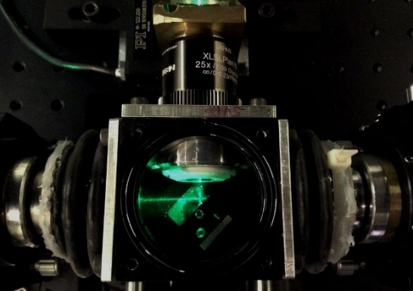

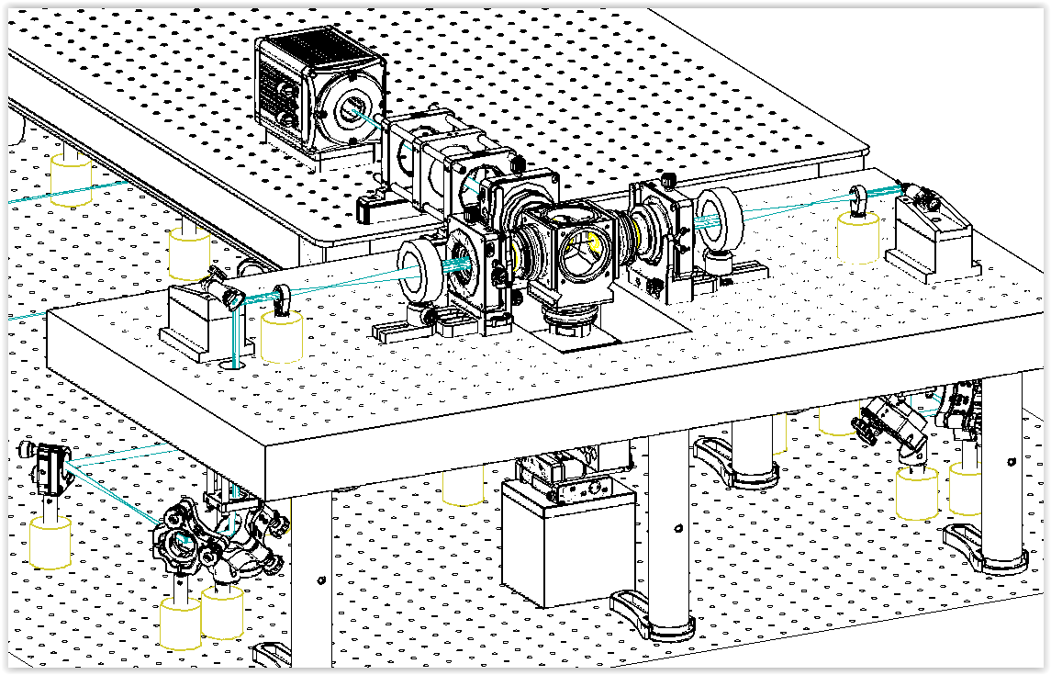
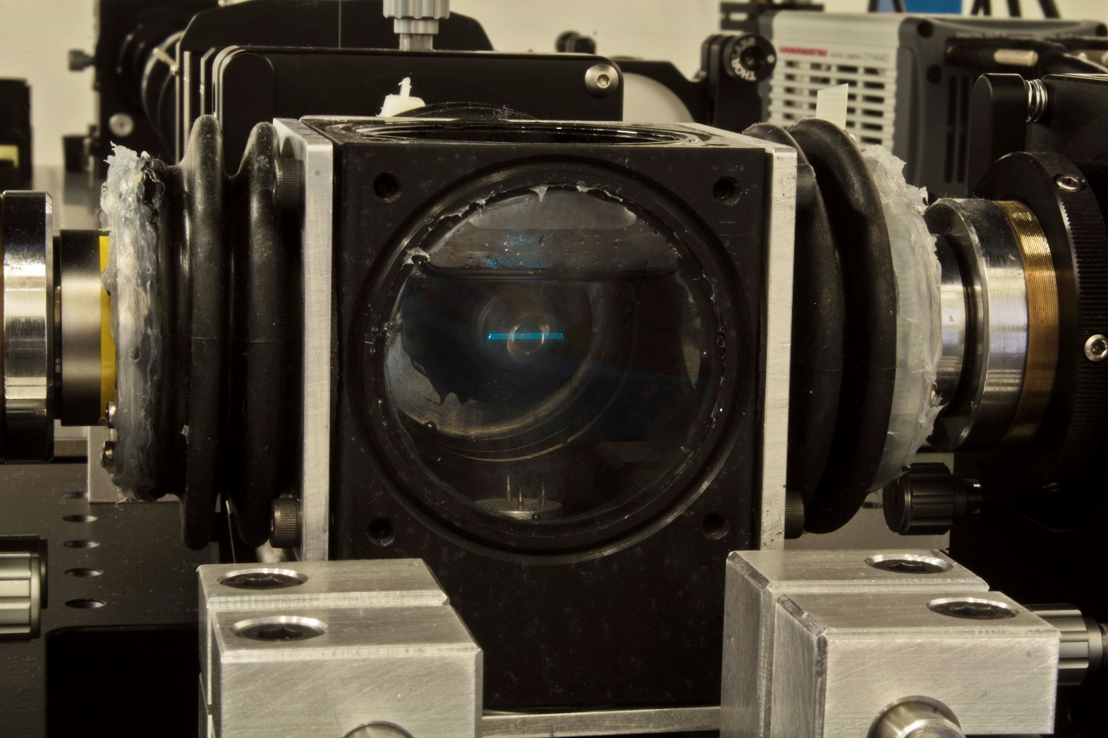
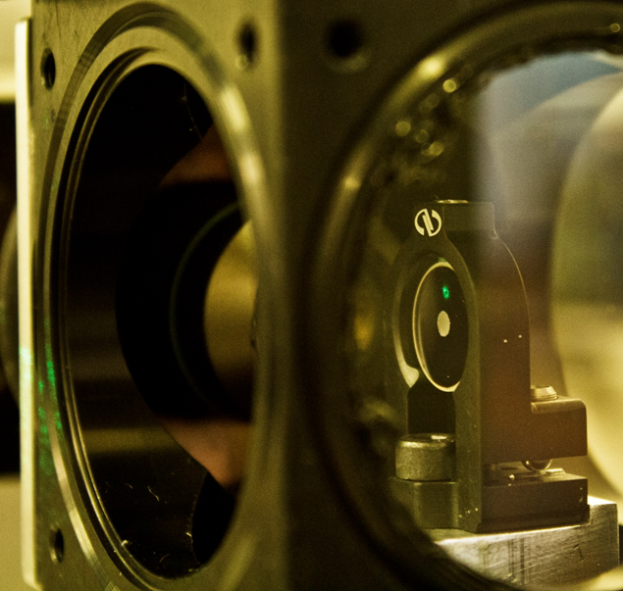

Slide 18
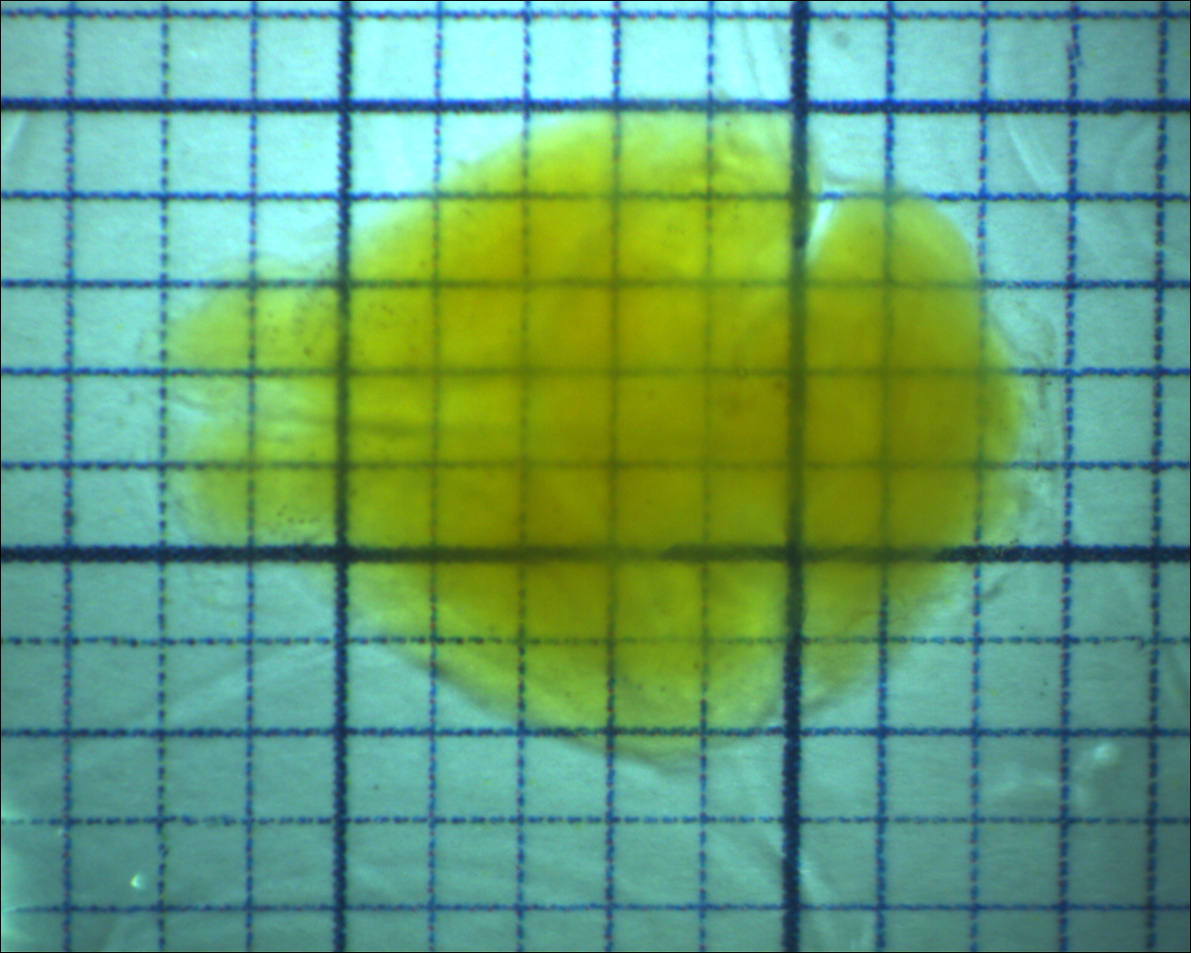

Slide 19
A
B
Tomo
Motor stages
USB
X
Y
Z
θ
Laser
Stack
Data Transfer
PC 1
USB
RS232
Laser
RS232 Hub
Laser
Laser
AOTF
Laser
RS232
Camera
Motor Stages
Galvo A
DAQ
AO
Galvo B
BNC
Ethernet
Custom Eletronics
Pulse
Amp.
Laser
Mod.
Int. BUS
AO & DO
BNC
Waveform
Generator
AOTF
DI
PC 2
BNC
Trigger output
Camera
CameraLink
DAQ controller
Lasers

Slide 20
Configure
Change hard-wired parameters (e.g. hardware ports names)
Update
Update run-time settings
(i.e. exposure time)
Main loop
Wait for user interaction and for messages from other components
Program start
Initialize
Set up hardware connections and load drivers
Terminate
Close all connections and drivers
Program end
Start
Begin grabbing images
Proceed
Grab images and decide to continue or not
Stop
Stop grabbing images

Slide 21
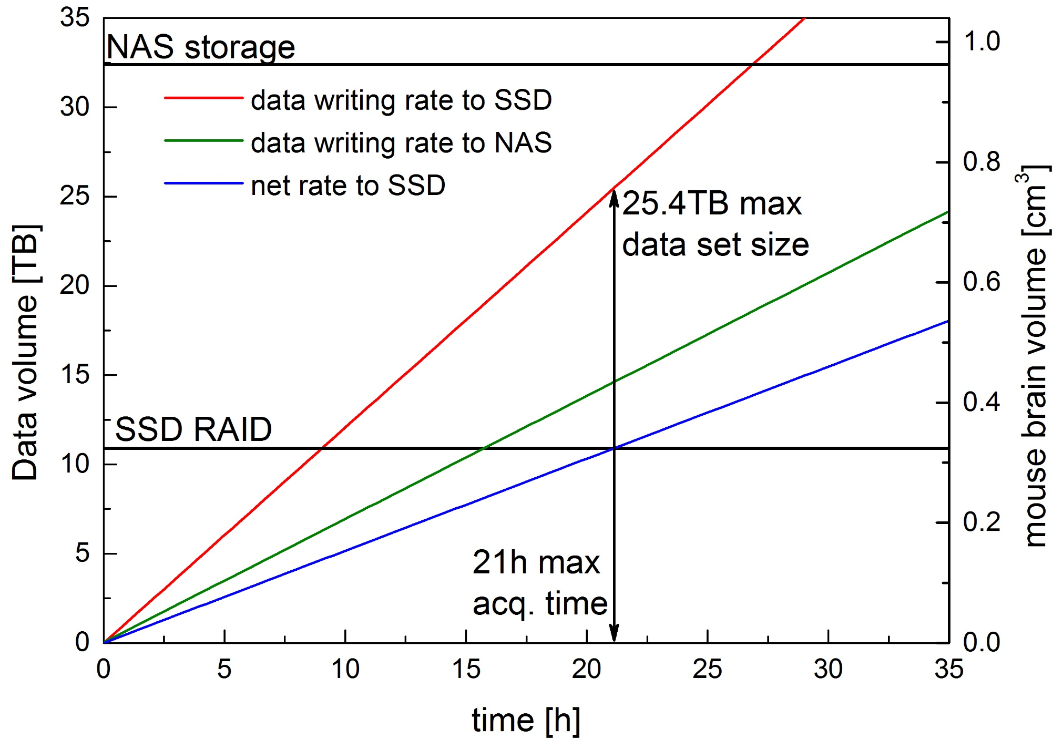
A
B
Camera
10 Gb Optical fibres
Remote repository
CINECA
CameraLink
board
10Gb network card
System
bus
Network-attached storage
32.4 TB
Raw data stream
Local SSD RAID 0
10.9TB
Data conversion stream
Transfer to remote repository
Workstation
Laboratory

Slide 22
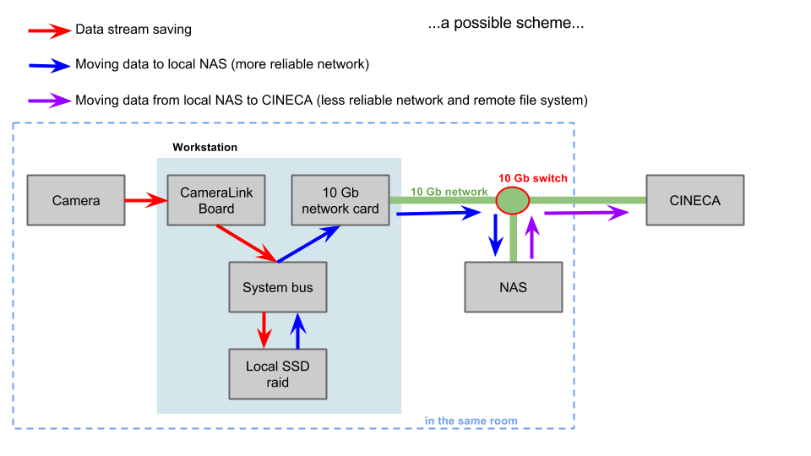
Data management
Python script from collaborators in Rome:
digitally downsample our images
transfer from SSD to NAS
Convert from .xcd to .tif
→ decrease of size by factor 10
32.4TB
10.9TB

Slide 23
Tomo
Stack
Data transfer
aquire image sweep:
# of frames
file name
Camera
move:
speed
step
SPIM imaging
AOTF
PI stages
Laser
DM mirror
cameralink
DAQmx
serial
USB
serial
Pockels cell
Galvos
Camera
AOTF
stages
Laser
DM mirror

Slide 24
Tomo
Stack
Data Transfer
Camera
Motor Stages
Waveform
Generator
AOTF
(Shutter)
DAQ
Board
Laser
Modulator
Galvo
Scanners
Lasers

Slide 26
AD f=100
AD f=100
AD f=50

Slide 28
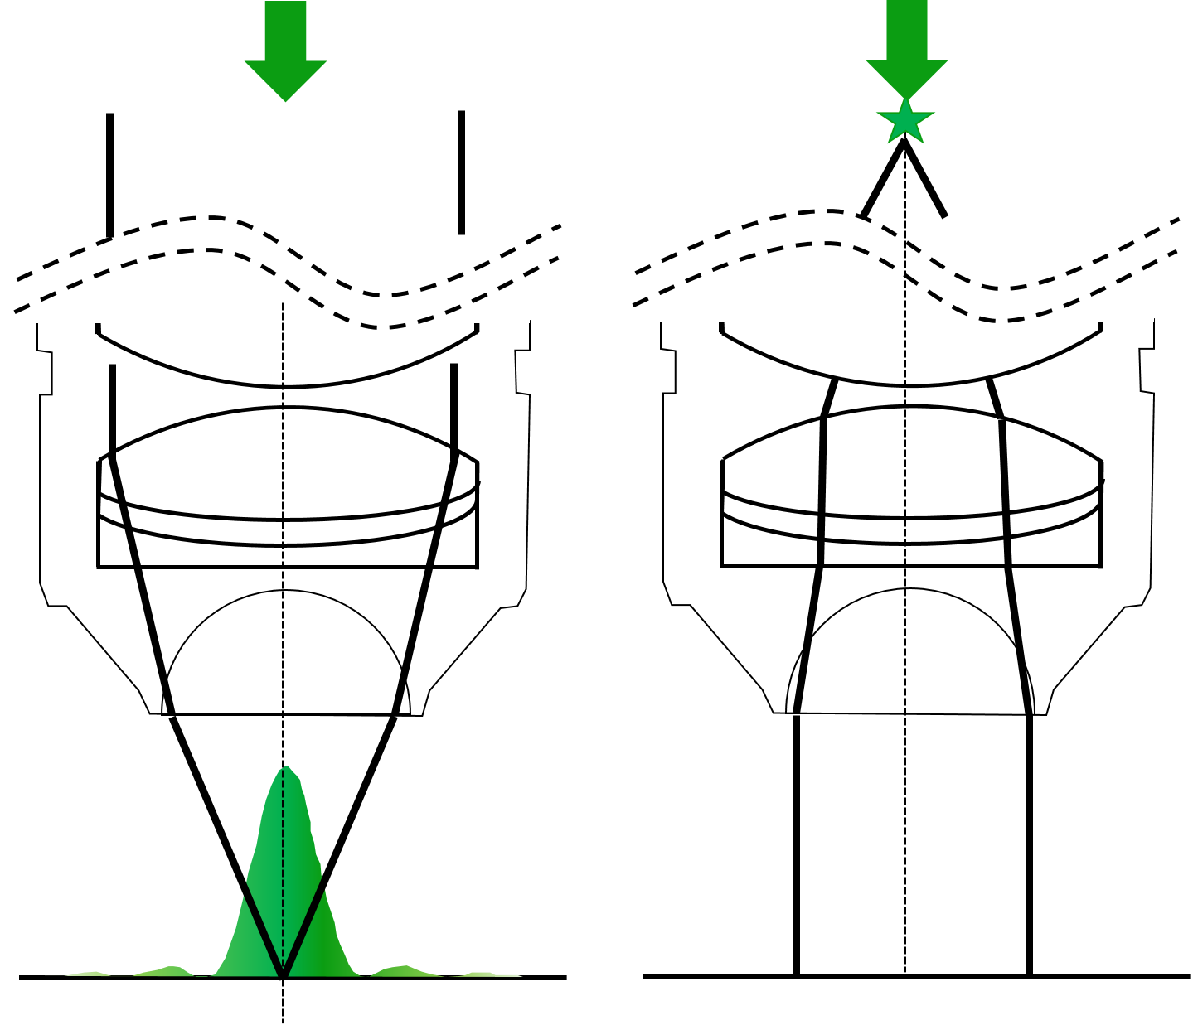
A
B
C
D

